Slide 1
SOCIAL MEDIA TREND ANALYSIS
Sharmila Kanthaiya Srinivasan s_k309@txstate.edu
Bobby Srisan sbs98@txstate.edu
December 04, 2019
CS7311

Slide 2
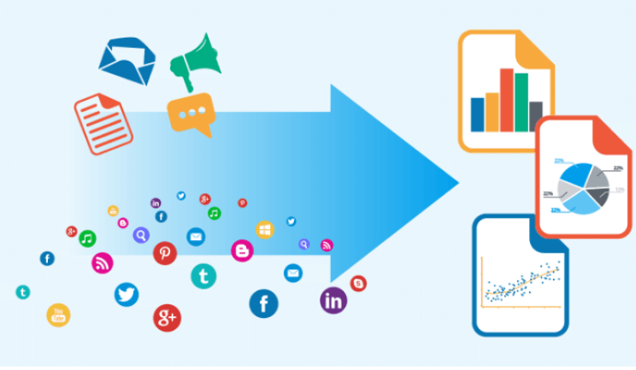
Introduction
The practice of social media data mining collects and processes of unstructured information (things such as posts, comments, tweets, images) shared on networks like Facebook and Twitter.
Is used to discover patterns and trends from social media platforms

Slide 3
Project: USING A Flexible pipeline to analyze trends on social media
Goal: Given a main topic, we have a process to analyze data and cluster communities and phrases.
This pipeline can be used, for example, to further inform research on data consumption behavior.

Slide 4

case study using ds pipeline
What do the interactions around #MeToo conversation look like?

Slide 5
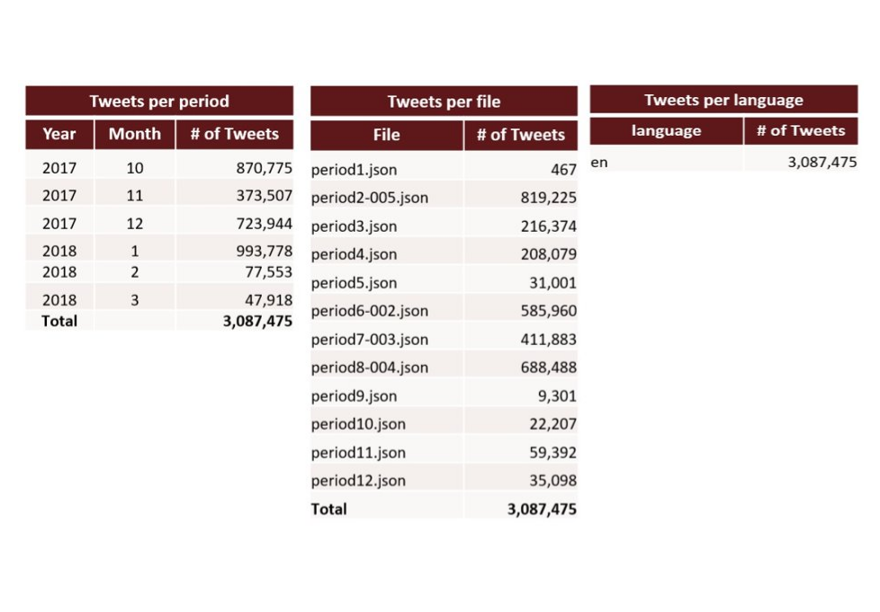
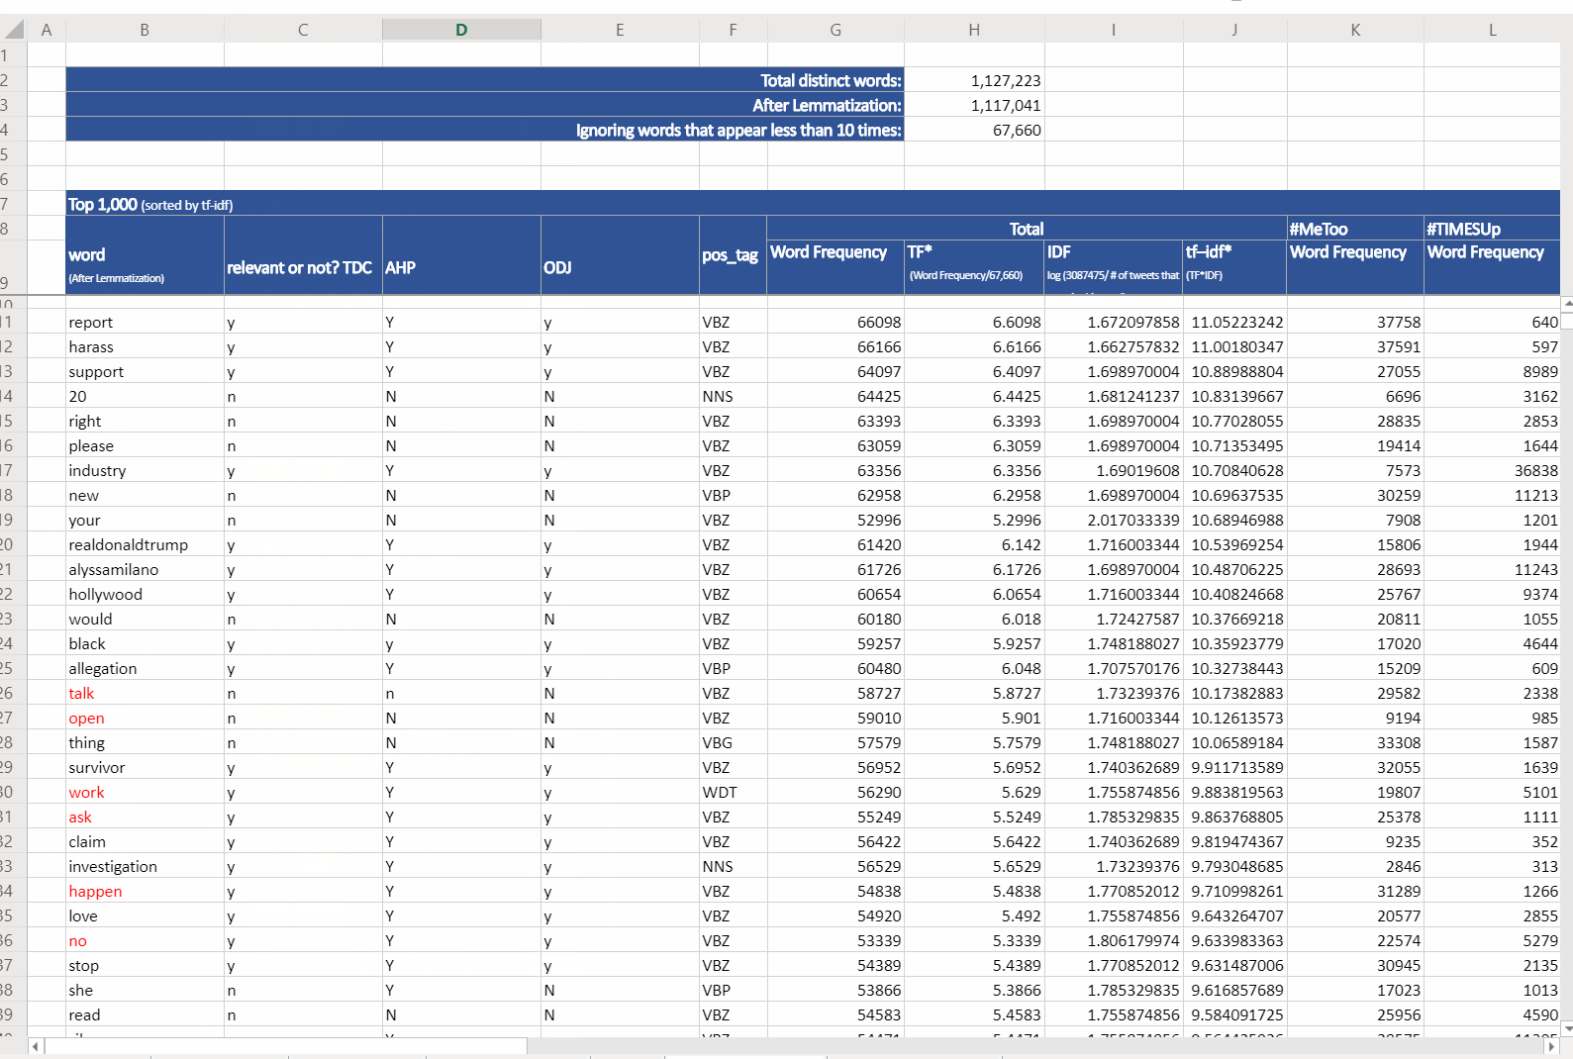
Dataset
3.1 million tweet documents provided by Dr. Olivia Johnson, Family and Consumer Sciences department.
Feedback about words.

Slide 6
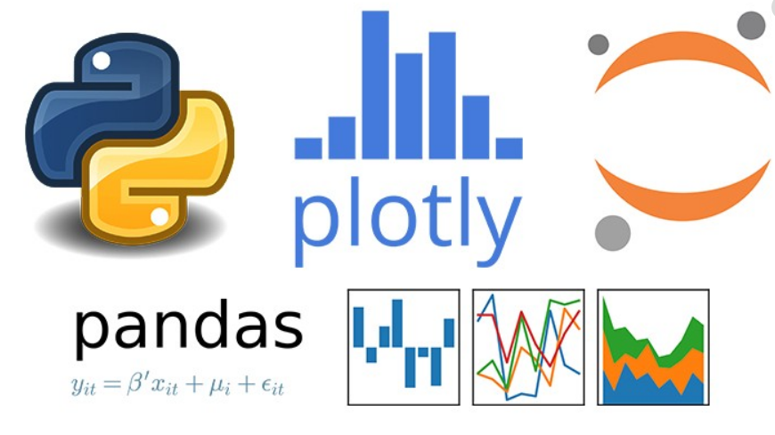



Tools
EDA: Juptyer, Scikit-learn, Gensim, python-louvain, natural language tool kit.
Data pipeline: MongoDB
Models: Latent Dirichlet Allocation, Louvain modeling method

Slide 7
Steps
Clean dataset by removing common and unrelated words.
Integrate feedback on relevant phrases to create n-grams that include these words.
Create graph from data and discover baseline communities using Louvain Modularity.
Post-processing module: From top 5% communities pull top 5% users

Slide 8
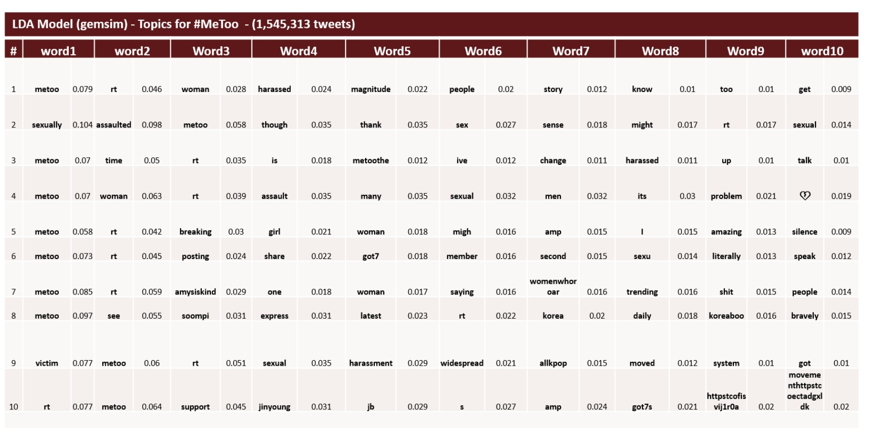
Partial results from original work – Unlabeled classification of phrases

Slide 9
User aggregation
Total
Number of unique Users who tweeted: 1142210
Total
Number of reply users to the post: 78699
Total
Number of mention users in the tweets: 256297

Slide 10
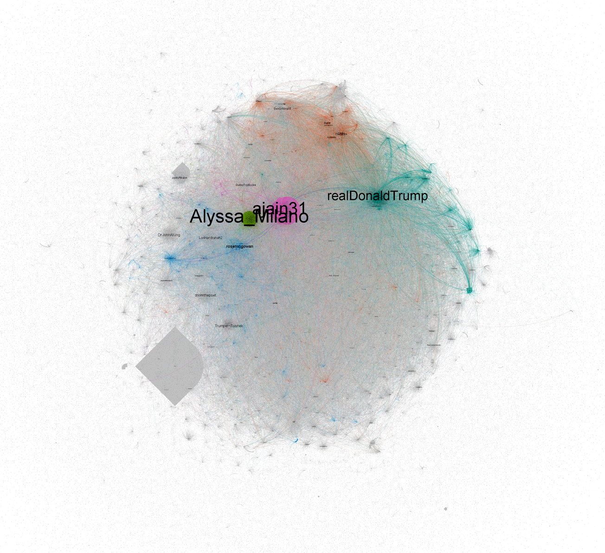
Community
Number of users/nodes in graph 3075359 Number of edges in graph 1192042

Slide 11
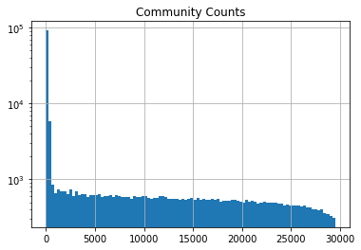
Community populations

Slide 12
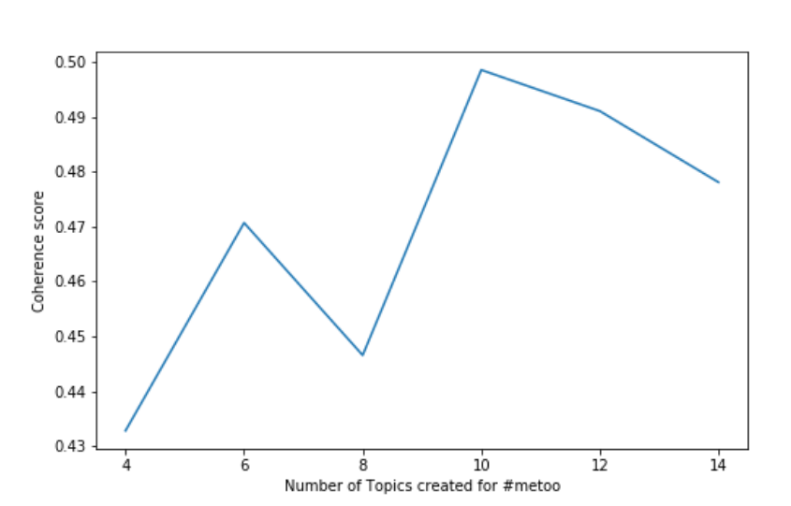
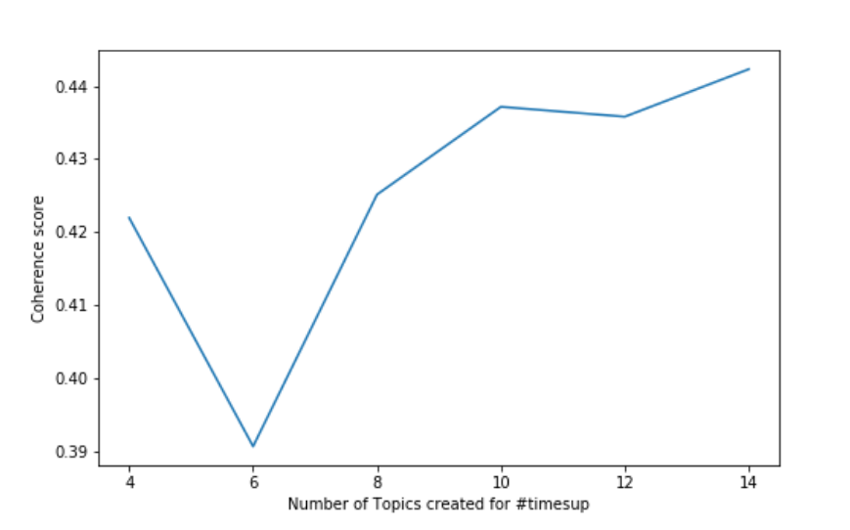
Optimal number of topics
Notes:
e coherence measure output for the good LDA model should be more (better) than that for the bad LDA model

Slide 13
Conclusions and Future Work

